Slide 1
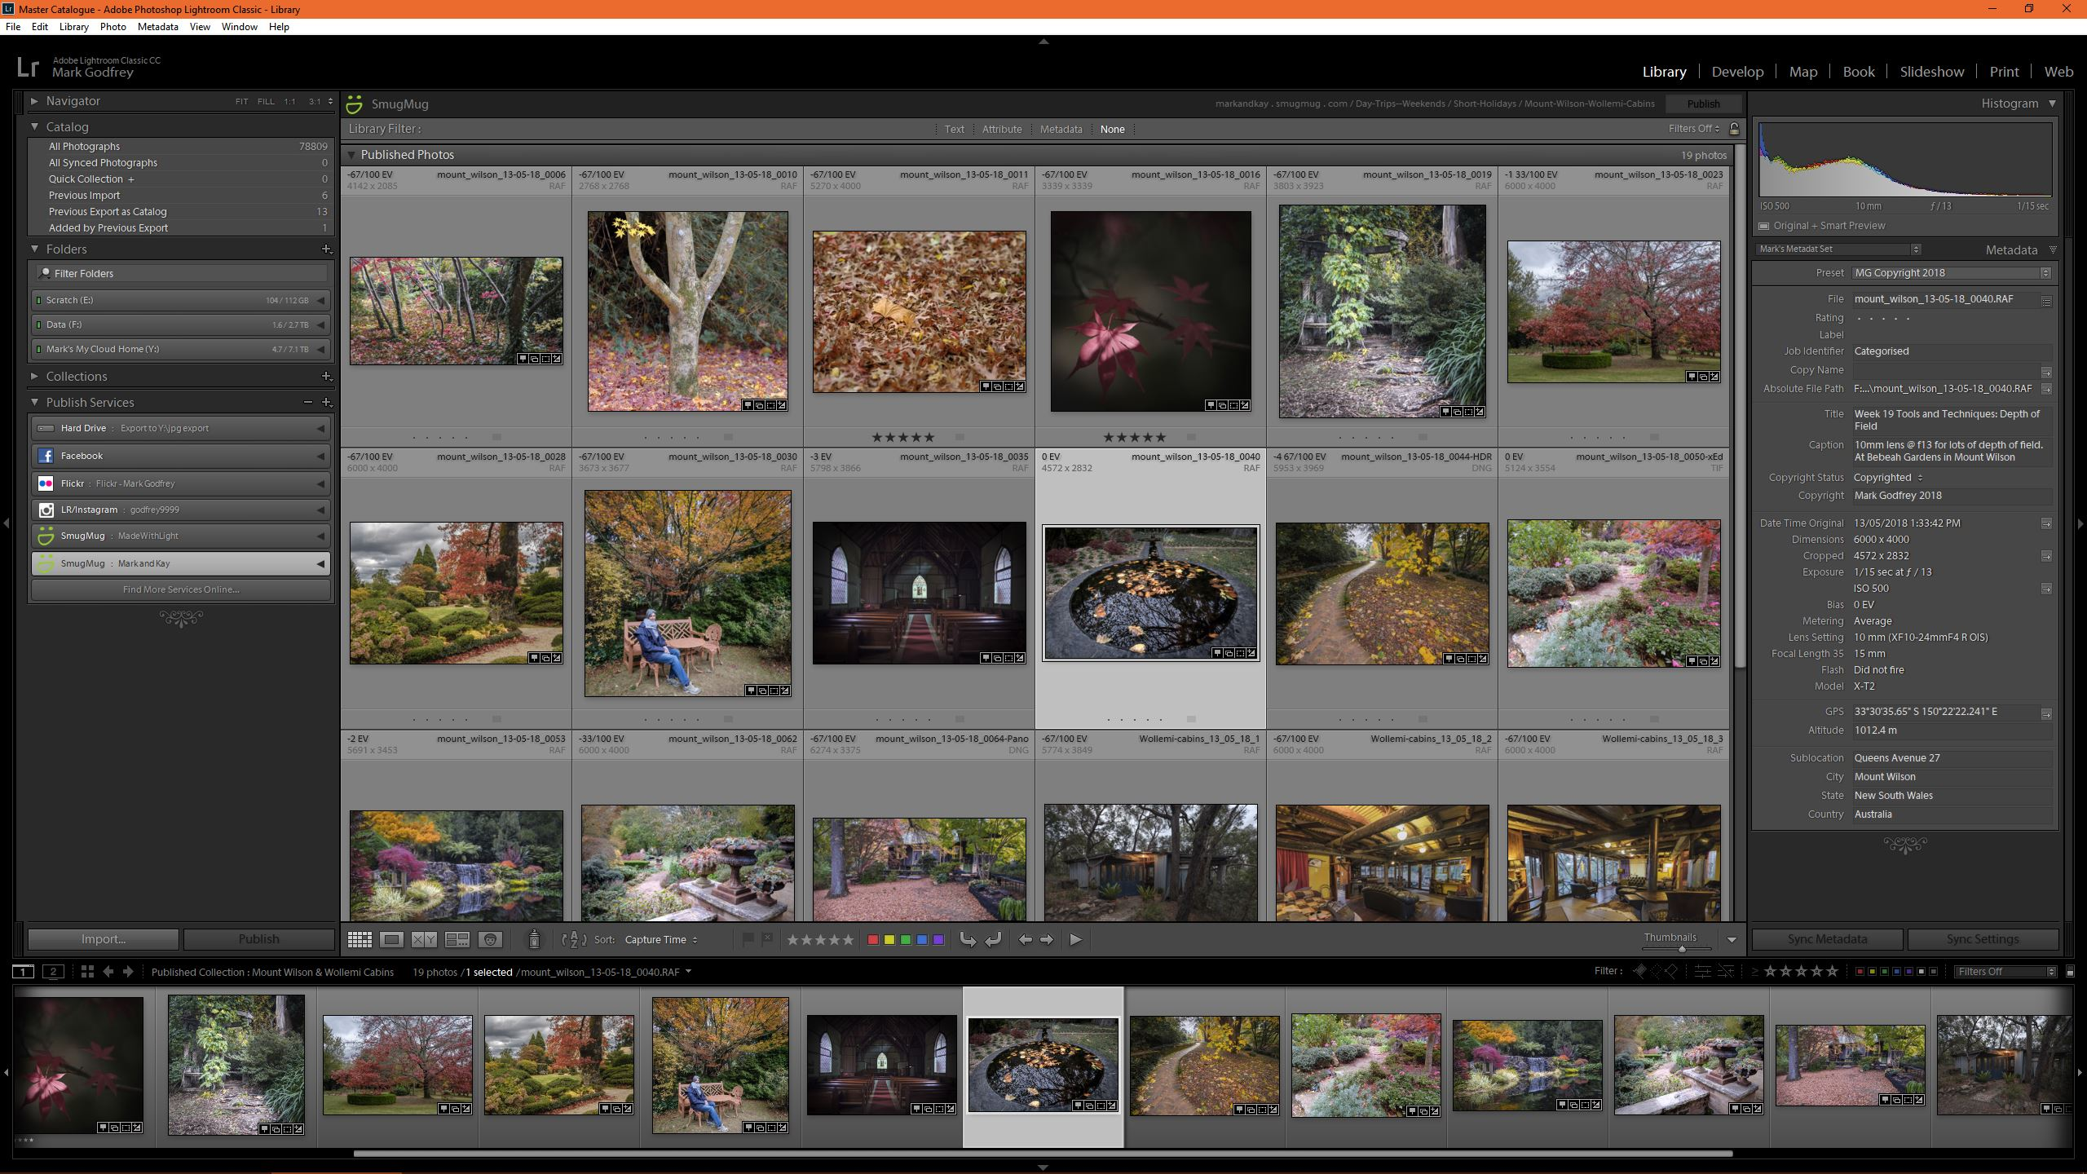
The Lightroom Sessions
A Quick Start Review – Pittwater Camera Club
Session 2

Slide 2
Aims of Session 2
Q & A from Session 1
Import photos into Lightroom with the Import Dialogue
    Selecting a source and Copy vs Move vs Add
    Using the File Handling, File Renaming, Apply During Import panels
    Choosing a destination and deciding on a folder structure
Lightroom Workspace – The Library Module
    Viewing, selecting, rating photos
    Collections, adding Metadata (title, captions, keywords, locations etc)
    Filters, searching and locating photos
Lightroom preferences and Catalogue preferences – software settings to help LR run smoothly – mostly use the defaults
Notes:
We’ll go at your pace so if too fast just say so
Ask lots of questions

Slide 3
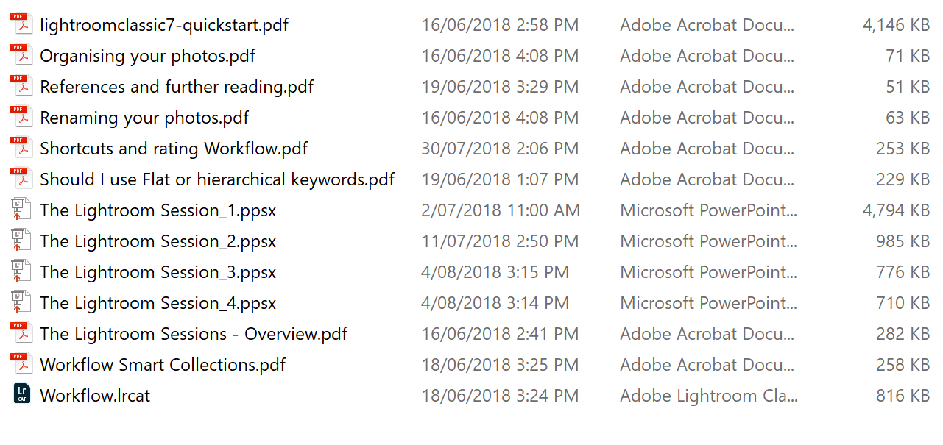
Copy Files from the USB
Copy the folder named “Copy this folder” it contains the files listed on right of screen
Notes:
Hand out USBs

Slide 4
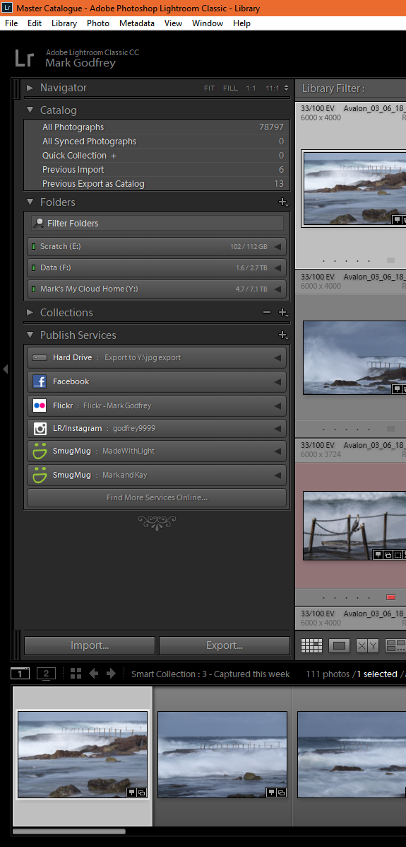

Import Photos
Import
  Remember – it means register your photos in LR’s catalogue and put them where you want them
Three types of import
  Copy images from a card or connected camera or a USB (or any removable device),
  Add images in their current location on your computer to LR’s catalogue , or
  Move images from a location on your drive(s) to another location on your drive(s)
Notes:
Demonstrate importing photos using the laptop and import into PWCC.lrcat Cover the following:
Remember Left to right is right; top to bottom is best
We’ll walk through
1. Camera/ card -> computer HD
2. Computer HD -> LR HD
Chapter 4 of LR Quick Start
The left-hand panel and the thumbnail display describe from where and what to copy while the left hand panels describe where to put them and what to do during the import process.
Select the source location in the panel on the left
Devices section : Select the camera or card reader or
Files Section: Select a folder from the files section
If you prefer click on top left corner of the import panel and choose the option you want
Thumbnails appear – might take awhile depending on how many
File handling at the top of the import dialogue
Decide on copy (as DNG), Copy Move or add
If using a device only copy options will be available
Add and move is available if importing from files
Next consider the Destination
Go through the options for date and into a folder
Optional features…
File handling – different sorts of previews, duplicates, temporary backup, add to 1 collection
File renaming – Use templates, custom text, shoot name, start number
Apply during import – Develop settings e.g. B & W, Metadata e.g. copyright, Keyword pre-set…but the same for all
Note, import pre-sets, sorting, thumbnail size etc
Finally click on Import
If time… Import into master.LRCAT using templates for file re-naming, adding to catalogue etc

Slide 5
The Library Module
Review of the Lightroom Workspace
Viewing
Selecting and rating photos – The best
Adding Metadata
Finding and Filtering photos
Creating and using collections
Notes:
Check if anyone needs to go over the workspace terminology if so use the demo catalogue and go through the workspace
Demonstration using PWCCsessions.lrcat
Review LR workspace
Chapter 6 of LR QS – the lightroom work space
Viewing
Chapter 7 of LR QS – Viewing your photos
Viewing - thumbnails
Grid view – J key cycles through type of thumbnails
Cover what the badges are on thumbnails and how to change them
Selections – multiple selections,
Viewing – photos in more detail
Loupe view – one photo, navigation
Zoom options
Survey view
Compare view
Viewing folders - Showing/hiding parent folders, photos in subfolders etc.
Selecting and Rating Photos
Chapter 8 of LR QS – Selecting the best photos
3 types of rating Flag, star, colour label – demo each – Flags don’t go to metadata
Colour labels can be changed
Rather than deleting photos one at a time mark them as rejects and delete in one go Don’t delete photos out side LR!!!
Discussion
Hand out Rating sheet: what sort rating systems are good?
Adding Metadata
Chapter 9 of LRQS – Adding Metadata
Title and captions
Keywords switch to video on next slide
Map Locations
Copyright and pre-sets
Finding and Filtering
Chapter 10 of LRQS – Finding and Filtering Photos
Sort order
Using the filters on the filter bar
Creating and using collections
Do smart collections if time

Slide 6
Keywords Overview
https://www.youtube.com/watch?v=slkR-lfmLQ8
Keywords: Plus
https://www.youtube.com/watch?v=_SWVjyxxQzo

Slide 7
Lightroom Preferences
2 sets
  Lightroom Preferences
    Default catalogue
    Store pre-sets with Catalogue
    Interface – background colours
  Catalogue Settings
    Backup setting
    Metadata panel – check all but face detection
Notes:
Only looking at some I change
Note the performance TAB and link to Adobe’s suggestions

Slide 8
Homework
Add more photos to your catalogue
Rate/Rank some for working on in the next Lightroom session where we will be looking at global image adjustments
Add some keywords
Create some collections

Slide 9
Session 3 Topics
Q & A from session 2 and homework
More on the Library Module
  Creating and using smart collections
The Develop Module
  Overview of the develop module
  Global adjustments
    Basic Image adjustments for colour
    Cropping, straightening, spot removal, sharpening, noise reduction, lens corrections and transformations, vignetting and adding grain, tone curve, HSl and split toning
    Undoing, history, before and after

Slide 10
END

