Slide 1
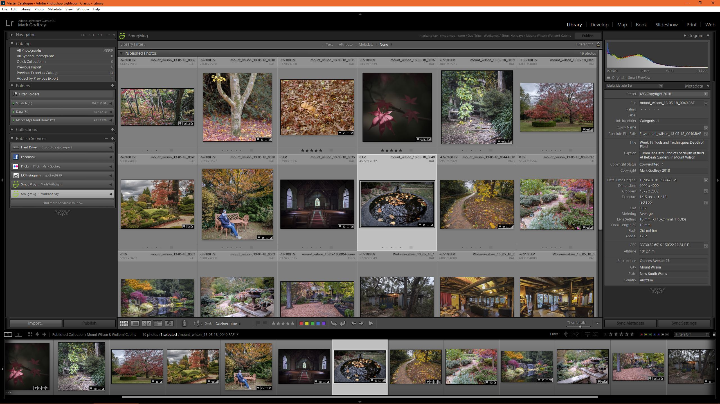
The Lightroom Sessions A Quick Start Review – Pittwater Camera Club
Session 3

Slide 2
Aims of Session 3
Q & A from session 2 and homework
More on the Library Module
Creating and using smart collections
The Develop Module
Overview of the develop module
Global adjustments
Basic Image adjustments for colour
Profiles, Cropping, straightening, sharpening, noise reduction, lens corrections and transformations, vignetting and adding grain, tone curve, HSL and split toning
Undoing, history, before and after
Sync develop settings

Slide 3
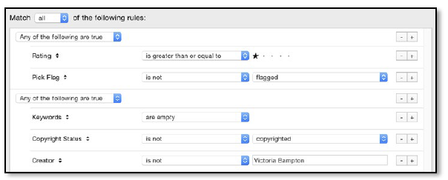
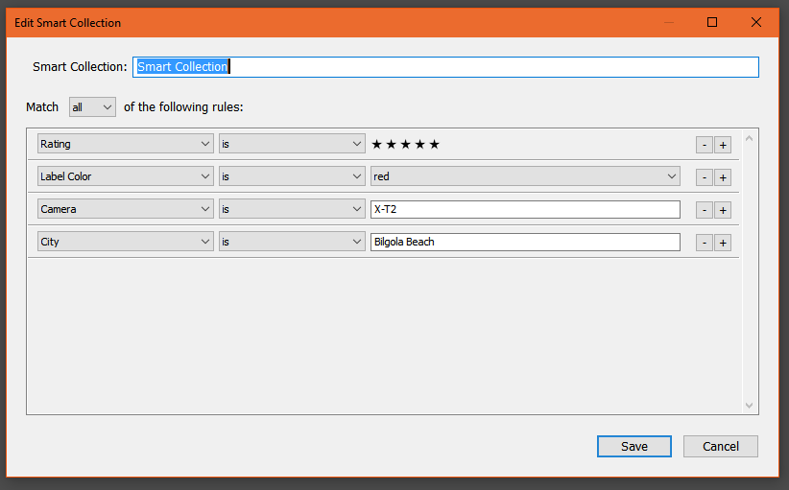
Smart Collections
Photos are added to smart collections automatically based on set criteria
More extensive filtering than the filter bar
God for managing workflow
Simple smart collections
{All, None or Any} criteria
Complex smart collections
Add further conditional rules
Notes:
I find Complex smart collections hard to create
Hand out Workflow smart collections pdf – the workflow.LRCAT referred to is on the USB
Show how to import workflow.LRCAT
Review the workflow collection in master catalogue

Slide 4
Smart collections
https://www.youtube.com/watch?v=S4gBOqjw-IU
Searching collections
https://www.youtube.com/watch?v=qyJ9s7pPdGk
Notes:
Video on collections

Slide 5
The Develop Module – Global adjustments
Fix big problems first - basic panel
Usually follow top to bottom but maybe go back re-do some sliders
RAW files dull and don’t look like the LCD on the back of the camera?
Have a look at ‘profile’ at the top of the basic panel – LR ships with emulation profiles for many cameras – different profiles depending on what camera shot the photo.
Move the sliders all the way to see what they do – usually only a small amount is needed though.
Use ‘Auto’ it’s usually a good starting point…and sometimes all that is needed…but sometimes not!
Notes:
Overview on slide
Demo using PWCC.lrcat
Histogram – same sort of things as is in the camera but finer detail.
Original + Smart preview – advanced
Crop and local adjustment tools – I do crop first, local adjustment tools covered in next session
Treatment: Colour or B&W – We’ll look at B & W later
Profiles: Camera specific
WB – selector tool and options under ‘as shot’
Go through each slider
‘Normal’ workflow…
Exposure-> WB -> black and white points (alt key) ->…Highlights/ shadows/ Contrast/ Clarity/ Vibrance/ Saturation/ Dehaze…can all be used as required
Recommended by the book… WB -> Exposure -> Highlights and shadows -> Whites and Blacks -> Clarity -> Contrast -> Vibrance/ saturation
May need to go back and re-do some e.g. WB
Undoing: Ctr Z or history panel; Re-set button, double click on name of slider, hold down alt to reset tone or presence in one go
Before/ after views – backslash ‘\’ , or Y for side by side
Virtual copies – virtual copies show as duplicate photos but are not

Slide 6
The Develop Module – Global adjustments
Basic
Tone Curve
HSL/Colour sliders
Split Toning
Detail panel
Sharpening – default 25 for RAW, 0 for jpeg
Noise reduction
Lens corrections
Transform (straighten images)
Effects (vignette and grain)
Calibration (of RAW processing – can create your own camera profiles)
Synchronising develop settings
Notes:
Demonstrate using PWCC.lrcat
Tone Curve
Note targeted adjustment option
Point curve versus region curve
Pre-sets under point curve
HSL/Colour sliders
Split Toning
Most useful for black and white. Can add warmth or cool
Detail
Sharpening
zoom to 1:1
Masking hold down alt key
Lens Corrections
Profile corrections dependent on camera/lens type
Manual correction if no profile
Transform
Correction for verticals etc
Auto or guided
Effects
Adjust for crop
Calibration - advanced

Slide 7
Homework
Create some smart collections that capture your rated photos
Develop some images using the global adjustments
Search for some free profiles and pre-sets, figure out how to install them (whoever supplies them usually tells you!) and try them out
E.G. Thomas Fitzgerald (profiles) or Adobe Exchange (Sort by price low to high to see the free things)

Slide 8
Session 4 Topics
Q & A from session 3 and homework
Local Adjustments
Gradient, radial and brush adjustments
Black and White Adjustments
Profiles
B&W panel
Split toning
Copying settings to other photos; Sync and Auto Sync
Saving settings to apply to other photos – Pre-sets
Creating Panoramas (stitching)
Editing in external programs
Photoshop
Nik, Luminar 2018

Slide 9
END

