Slide 1
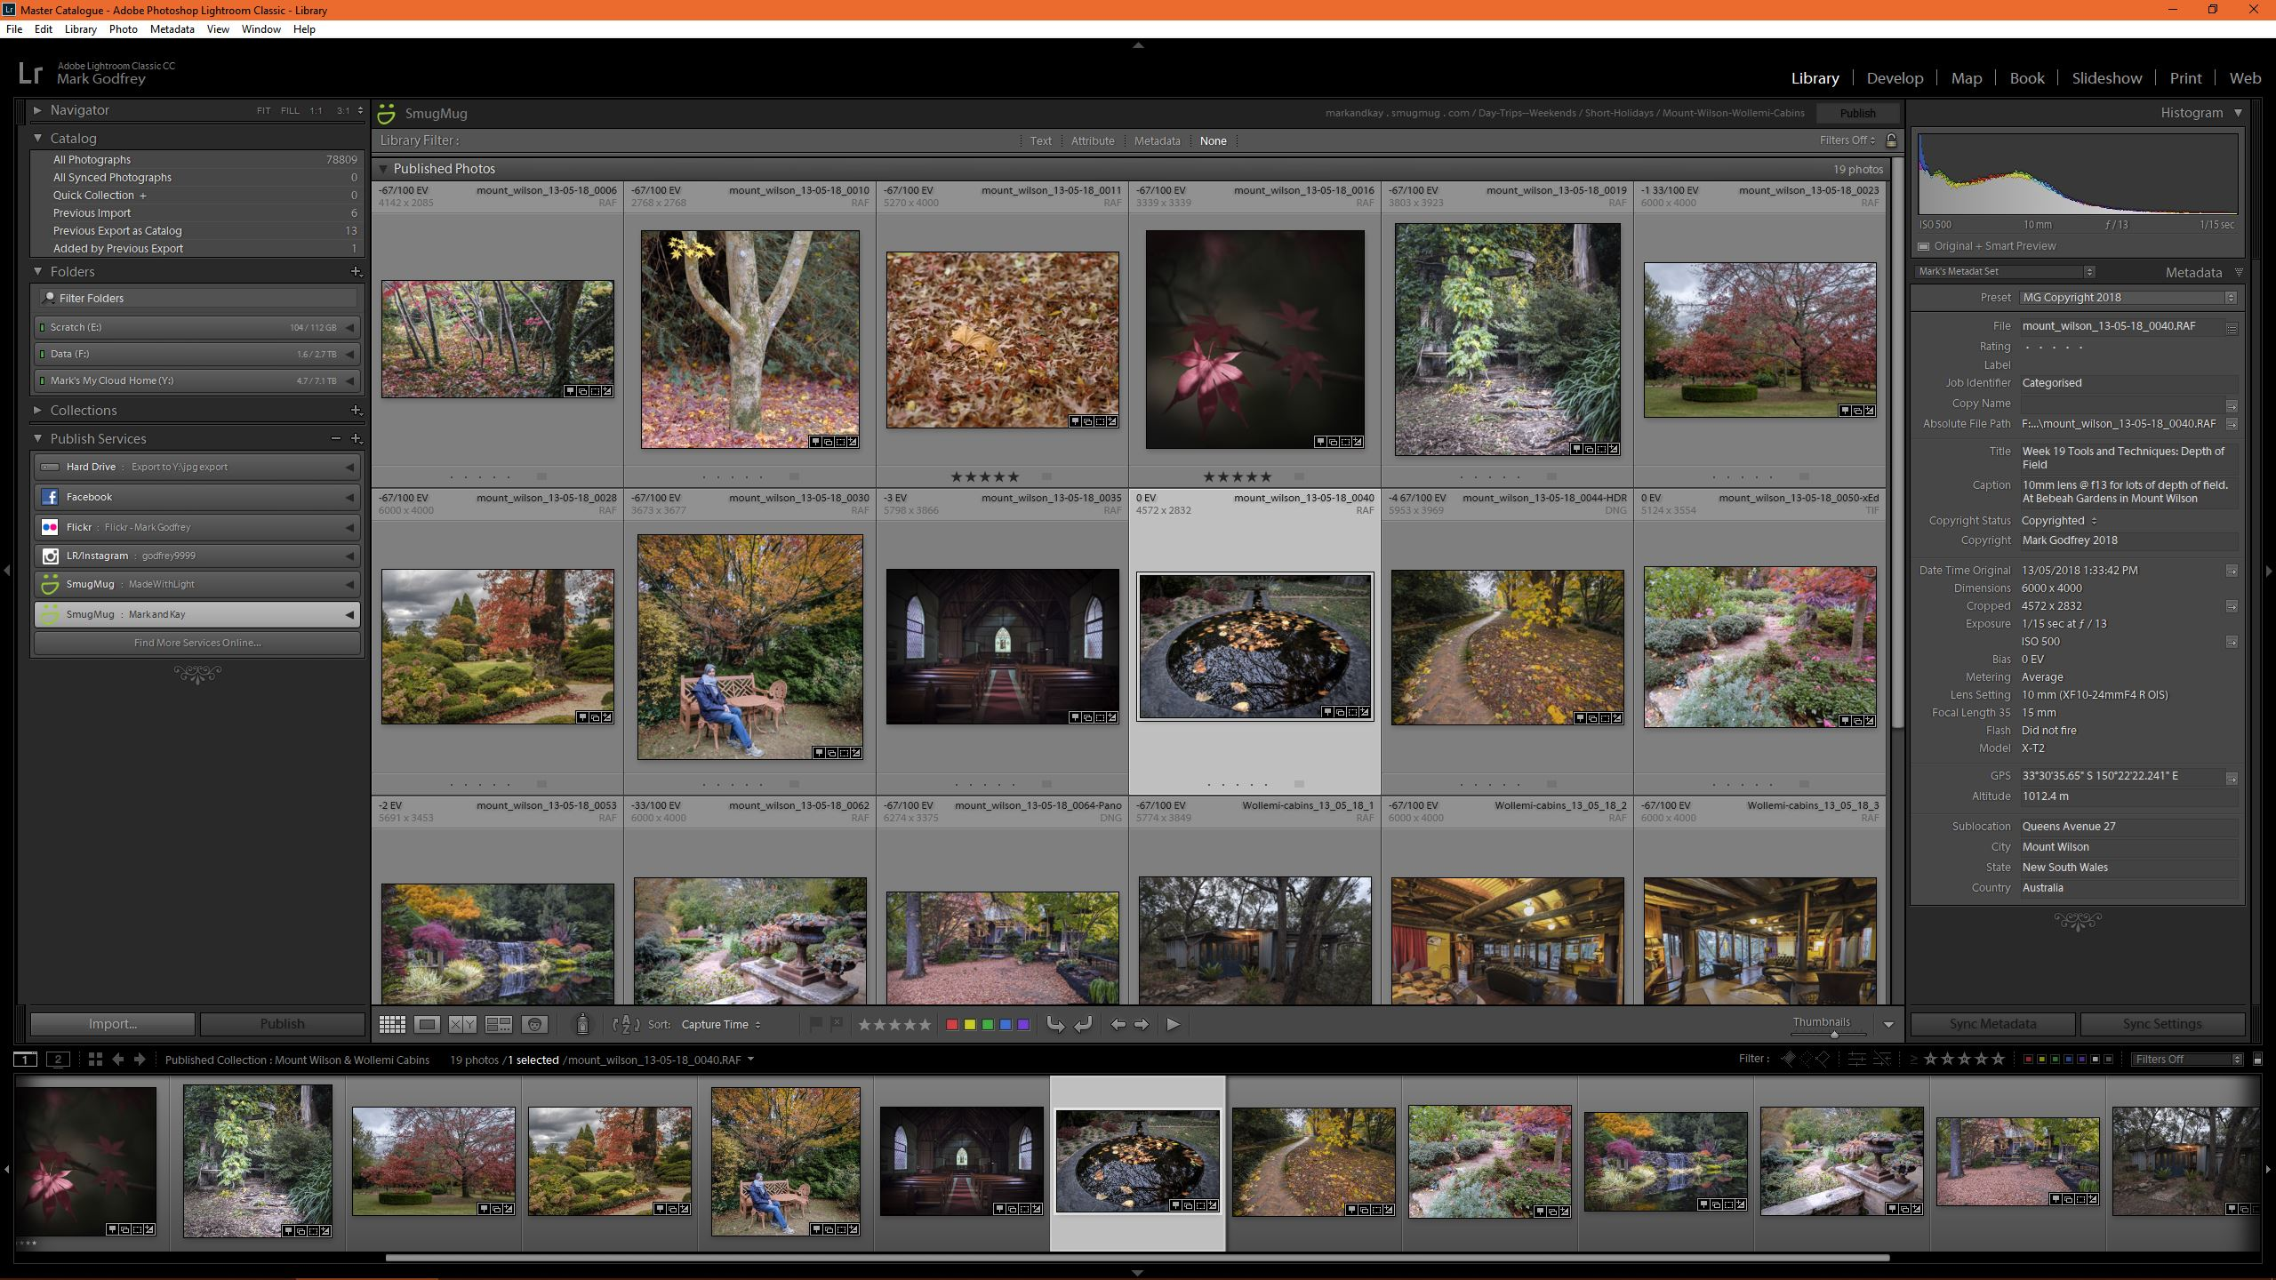
The Lightroom Sessions A Quick Start Review – Pittwater Camera Club
Session 4

Slide 2
Aims of Session 4
Q & A from session 3 and homework
The Develop Module
Local Adjustments
Gradient, radial and brush adjustments
Black and White Adjustments
Profiles
B&W panel
Split toning
Saving settings to apply to other photos – Pre-sets
HDR and Panoramas (stitching)
Editing in external programs
Photoshop
Nik, Luminar 2018

Slide 3
The Develop Module
Local adjustments – i.e. apply to a section of an image
Crop tool: straighten, aspect, angle, overlay
Spot removal
Red Eye
Graduated filter, Radial Filter, Brush
Effects, saving a pre-set, fading the effect, Range mask, brushing the effect, show overlay, feathering, applying colour overlay, auto mask, erase, brush flow and density
Can also Synchronise local adjustments – very useful for spots!
Notes:
Work on an image to demonstrate each one

Slide 4
Black and White Adjustments
Basic panel – “Treatment: Colour or Black and White”
Clicking on Black and White changes the “HSL/Colour” panel to “B & W”
All the other panels adjustment tools work the same as for colour
B & W panel – darken or brighten the tones in the image corresponding to the colours
Auto is a good starting point
Also B & W profiles in the basic panel – don’t effect the sliders in the B & W panel
Calibration panel can provide some finer control to the colour mix too
Split toning panel is effectively “Duo-Toning”
Selective colour using HSL – not B & W

Slide 5
Saving Settings to apply to other photos
Apply the adjustments done to one image to another (or more) images
Can be done ‘on the fly’ through sync settings already covered
Or save as a pre-set
Create a pre-set
Note: Auto settings
Can be grouped
Manage pre-sets
Apply on import feature

Slide 6
HDR and Panoramas
Frist take some images to stitch or for high dynamic range
Select all the images in the set
Photo merge to panorama
Try different projections, auto crop or not, move the boundary warp slider to fill in
A new “dng” image is created – still a RAW file
Photo merge to HDR
Check auto-align and auto settings (it just applies Auto and can be changed)
Deghost handles moving objects

Slide 7
Editing in external programs
Some external editors are accessed a little differently
Through ‘edit in’ menu
Photoshop
NIK – eg silver effects pro
Creates a new file - these get stacked together, included in collections, same metadata etc
Can choose to have lightroom adjustments applied or not
Through ‘plug-in extras’
Luminar 2018
May need to sync folders
Creates new file but hwo it’s handled varies, not stacked, not in collection etc.

Slide 8
Homework
Edit some photos using both local and global adjustments
Edit some images and do the round trip from lightroom to photoshop and back

Slide 9
Session 5 Topics
Q & A from session 4 and homework
Exporting images
Types of exports
Saving export parameters as a pre-set
Setting up an export pre-set for submitting images to PWCC comps
Publish Services
Printing images on a printer at home
The print module – we’ll do everything but actually printing an image
Easy tryptich
Contact sheets – printing to a file

Slide 10
END

